Slide 1

ATLIQ GRANDS HOSPITALITY ANALYSIS
Created and Presented by:
UTKARSH VATS

Slide 2
Problem statement
AtliQ Grands owns multiple five-star hotels across India. They have been in the hospitality industry for the past 20 years. Due to strategic moves from other competitors and ineffective decision-making in management, AtliQ Grands are losing its market share and revenue in the luxury/business hotels category. As a strategic move, the managing director of AtliQ Grands wanted to incorporate “Business and Data Intelligence” in order to regain their market share and revenue. However, they do not have an in-house data analytics team to provide them with these insights.

Slide 3
Task List
We have been provided a sample data and a mock-up dashboard to work on the following task:
Create the metrics according to the metric list.
Create a dashboard according to the mock-up provided by stakeholders.
Create relevant insights that are not provided in the metric list/mock-up dashboard.

Slide 4
AIM OF THE PROJECT
To provide insights to the revenue team of AtliQ Hotels by utilizing the data.

Slide 5
AtliQ
Bangalore
Delhi
Mumbai
Hyderabad

Slide 6
AtliQ
Bangalore
Delhi
Atliq Bay
Atliq Blu
Atliq City
Atliq Exotica
Atliq Grands
Atliq Palace
Mumbai
Hyderabad
Atliq Bay
Atliq Blu
Atliq City
Atliq Grands
Atliq Palace
Atliq Bay
Atliq Blu
Atliq City
Atliq Exotica
Atliq Grands
Atliq Palace
Atliq Seasons
Atliq Bay
Atliq Blu
Atliq City
Atliq Exotica
Atliq Grands
Atliq Palace

Slide 7
Dataset Details
We are provided 3 moths booking detail data of all the AtliQ Hotels.
Dataset contains 5 excel files.
Dim_date
Dim_hotels
Dim_rooms
Fact_aggregated_bookings
Fact_bookings
Metric list excel file
Mock-up Dashboard

Slide 8
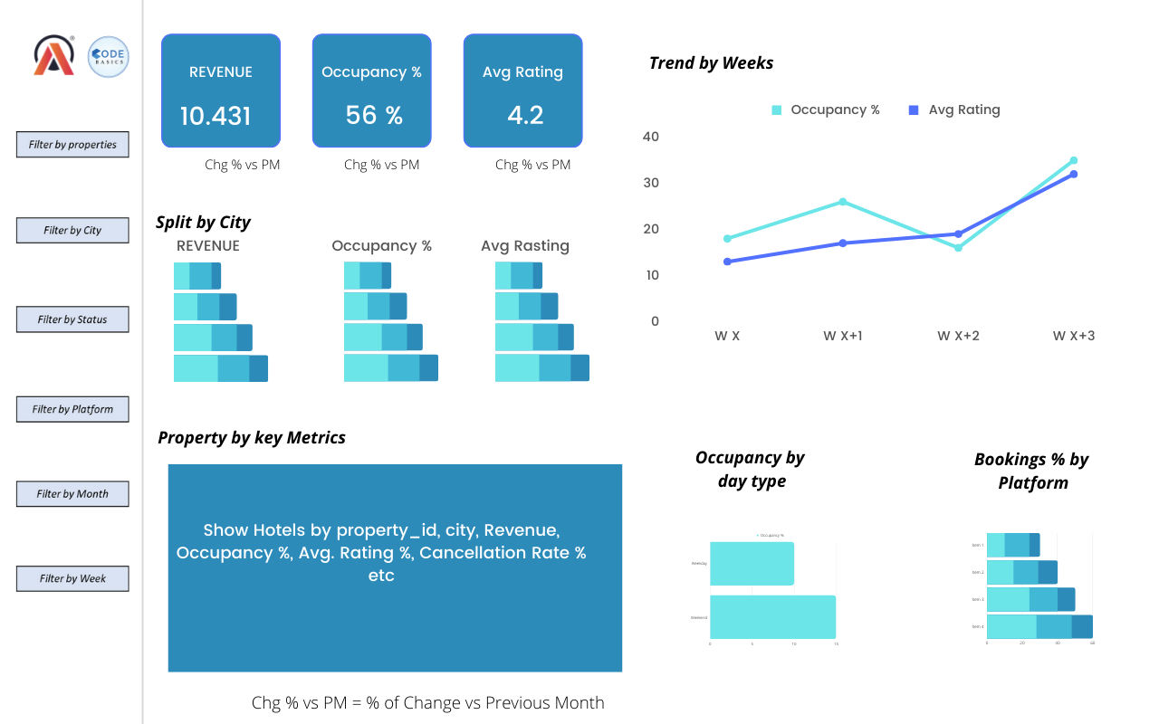
Mock-up Dashboard

Slide 9
Expected outcome after this analysis?
Regain their market share in the luxury/business hotels category
Understanding the revenue trend by week/month/day
To get insights where business is failing and what can be done to tackle them

Slide 10
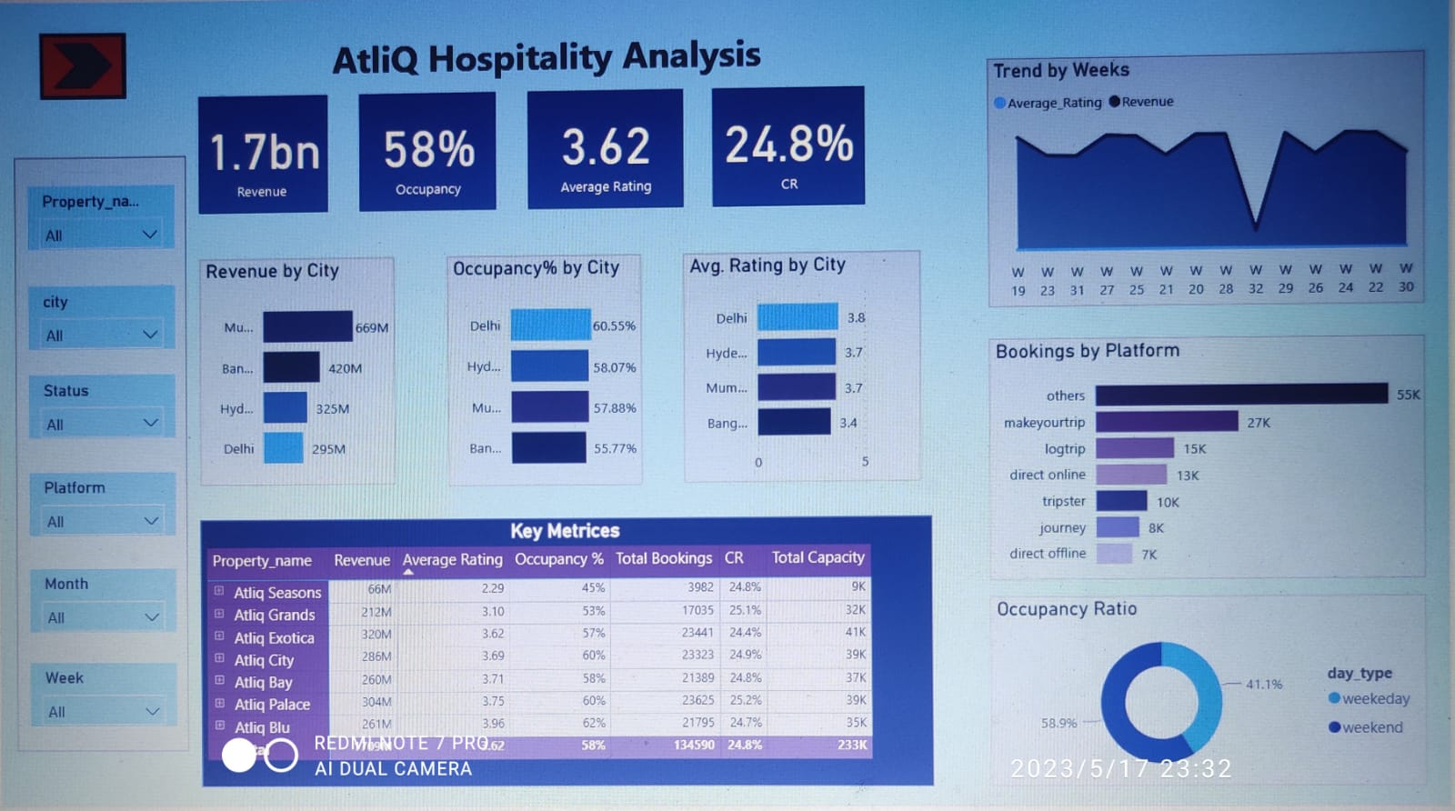

Slide 11
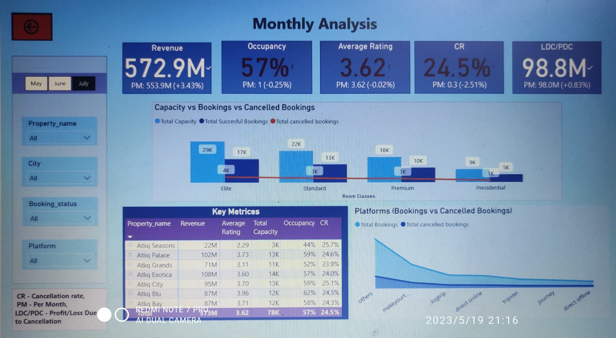

Slide 12
FINDINGS AND INSIGHTS
Mumbai generates the highest revenue of 669Million followed by Bangalore, Hyderabad and Delhi.
AtliQ Exotica performs better as compared to all types of hotels with 320 Million revenue, rating as 3.62, Occupancy percentage as 57 and Cancellation rate as 24.4%.
AtliQ Bay has the highest occupancy of 66%.
Week no. 29 recorded the highest revenue among all, which is 139.7 Million.
Delhi tops both in occupancy and rating followed by Hyderabad, Mumbai and Bangalore.
AtliQ Hotels lost around 298 Million in terms of cancellation.
Among all Room Classes, the Elite type rooms accounts for highest booking as well as higher cancellation rates.

Slide 13
Learnings from the project
Learnt, how to use bookmarks and selection for different purposes. (Page navigation and clear filter button in the dashboard was achieved using bookmarks and selection. website like page navigation YouTube tutorial )
By referring different cancellation polices followed by different hotels, understood that most of the hotels charge zero fee, only if the booking is cancelled before three months of booking date. If the booking is cancelled after that, the charge range from 60 to 90% of the booking cost.

Slide 14
THANK YOU

